Slide 1
Bank Security
Moving to the Cloud Security with DevSecOps
Vince King

Slide 2







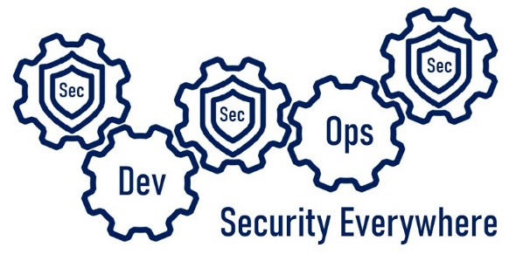

Who’s this talking to me now?
Vincent King
Senior Cyber Analyst
Head of DevSecOps
Bank of England
Reformed Developer
Secure Coding Subject Matter Expert
Qualys Certified Specialist
(ISC)² Certified Information Security Professional
DevSecOpsVince
Notes:
Bank of England for almost 10 years.
Reformed developer, Ops Lead and DevOps subject matter expert.
Cyber 4 years ago gaining experience.
I now lead the effort for DevSecOps within the Bank.
Is/is not.
Is an overview… Important … Start “doing” … Who should involved.
Not a discussion of tooling or vendors ... indepth course … the silver bullet

Slide 3



DevOps vs Security – The Perception
Dev
Dev
Sec
Ops
Notes:
Read what good DevOps looks like
Small teams working independently to implement their features, validating correctness in pre-production environments, with deployments into production happening predictably, quickly, safely, and securely, throughout the business day.
Not like the books?
Developer - saw Cyber Security as a blocker using tools and code-snippets - avoid Cyber department of “no”.
Ops lead - reason features took so long
DevOps lead - Cyber impediment to innovation - admin rights on every machine
Cyber Analyst - I was an idiot…. Cyber policies perceived as obstacles - clandestine reputation.
Things are changing! Cyber open to challenge decisions supported reason.
Alternatives to questionable activities and are more open about what we do within the department.

Slide 4

Where should Sec live?
Sec
Sec
Sec
Ops
Dev
Security Everywhere
Notes:
Where should Sec live? Well … everywhere.
Create a culture of collaboration at the earliest stages
Security, like testing, is an afterthought.
Problems are found too late - system moves forward, running at risk. Technical debt spiral. “we’ll fix this later”
Add in Cloud lead to a major compromise or data breach.
Security must work closely with Development and Operations, and most importantly, be an enabler.

Slide 5

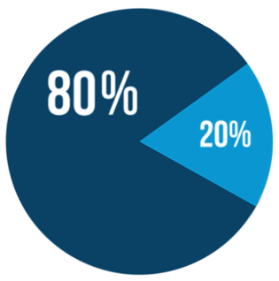
Where should Sec live?
Sec
Sec
Sec
Ops
Dev
Security Everywhere
Secure coding training
Code reviews
SAST
Secure code reuse
Gold container images
Secure code champions
Peer oversight
High trust team
Open Source code use
Newer container images
Notes:
Developers “80/20” divide
80% existing systems fixing bugs already productionised application
20% more senior, proactive use all the new tools highly trusted
80s need produce security code support peer review, clearly defined toolset. SAST and DAST tools with a clear feedback loop helps re-enforce positive behaviour.
Secure Code Champions support development teams. opportunity for training; first point of contact triage; threat modelling workflow.
Open source centre of a modern development team Log4j vulnerability
Security must be an enabler and support the use in a controlled manner
Move away from internet and grabbing libraries and instead curated collection
Containers approved list of images created, and maintained
20% “slightly” less restricted allowed to innovate
“high trust, virtual, team” deeper understanding of security concerns test-drive new tooling and components
Walled garden safe space for innovation approved, ways of working trickle down

Slide 6


Where should Sec live?
Sec
Sec
Sec
Ops
Evidence-based
policy setting
Dev
Security Everywhere
Documented
Use Cases
Policy
enforcement
CI/CD
pipelines
Infrastructure
as code
Challenge non-standard
architecture
Notes:
Everything as Code should replace manual processes provide predictable, reliable, secure, and faster deployments.
Use cases and understanding prevent over-engineering a solution
Challenge for some developers, it certainly was for me.
Everything as Code needs to be protected. Provide the same controls.
How we use the cloud. “lifting and shifting” should be the exception.
Cost and efficiency benefits through native resources and SaaS solutions.
Stick to VM-centric creating data centre and technical debt.
Developer use of cloud native resource, challenge the use of VMs.

Slide 7


Where should Sec live?
Sec
Sec
Sec
Ops
Dev
Destroy &
rebuild
Continuous
monitoring
Security Everywhere
Vulnerability
Management
Threat
Intelligence
Policy
compliance
Proactive
patching
Posture management
reporting
Notes:
Favourite concepts destroy and rebuild - pets versus cattle.
New server like a pet, care for it by updating and patching software, feed it with new applications and libraries. Never let it be turned off.
Cloud should be seen as cattle. When a head of cattle is ill, it is disposed of, and replaced.
Keeps us on top of any newly released vulnerabilities. Limit the potential persistence of any issues.
Inventory - you can’t protect what you don’t know about.
Threat intelligence and insights understand real risk and critical severity for us.
If you remember one thing from this presentation about monitoring it should be this … Risks without context are meaningless.

Slide 8





Vince’s Five Rules of DevSecOps in the Cloud
3
Set policies and enforce them through automation
1
Use the benefits cloud platforms gives you
2
Automate everything; where you can’t automate, secure the manual process
4
Report on compliance and make the data available to all teams
5
Tooling cannot fix all your problems, invest in people and processes
Notes:
Pressures/lack of capacity or capability = lift and shift. The more you build the more you have to work.
Creating technical debt that will, in all likelihood, outlive your role.
CAN be automated but we have to be realistic. Review manual process and make it as secure as you can.
Policies are the guardrails that protect us from ourselves
Use data to praise the good, and highlight the bad.
Combination of People, Process, and Technology. Culture of support, openness, and learning to retain the best staff
Invest in tooling to support your processes, and help your staff be more efficient.

Slide 9


And Finally…
Sec
Sec
Sec
Ops
Dev
Questions?
Security Everywhere
Vincent King
Head of DevSecOps for Cloud Transformation
Socio-Technical Security Posture Management
Bank of England
DevSecOpsVince

